Slide 1



WASTE MANAGEMENT SYSTEM USING IOT-BASED MACHINE LEARNING

Slide 2


Presentation Outline:
Introduction Problem in society Motive of Project Block Diagram Methodology Applications Conclusion

Slide 3



Introduction:
IoT provides exchange and linkage between low-energy devices and interactions through the Internet.
Many applications around the world have been implementing different operations, based on the background of IoT, to offer novel services for smart cities and optimize energetic efficiency.
This system is very innovative which will help you to keep the cities clean.
A web page is built to show the status to the user to moniter it.

Slide 4
The web page gives a graphical view of waste and highlights the waste collected in order to show the level of waste collected.
The LCD screen shows the status of the waste level.
The system uses ultrasonic sensors placed over the bins to detect the waste level and compare it with the garbage bins depth
Why we choose IOT?
It is the network of physical objects or "things" embedded with electronics,software,sensors and network connectivity ,which enables these objects to collect and exchange data.
Data and connected services are the real values of IOT Platforms.

Slide 5
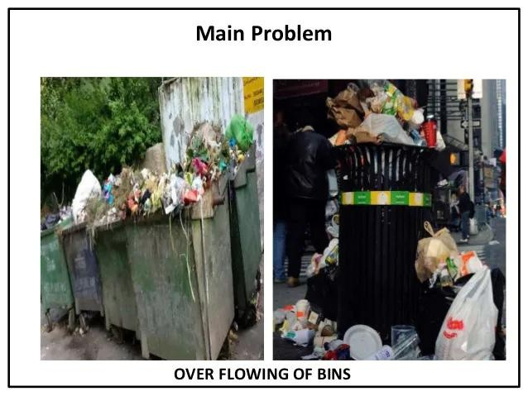
Problem in Society:

Slide 6
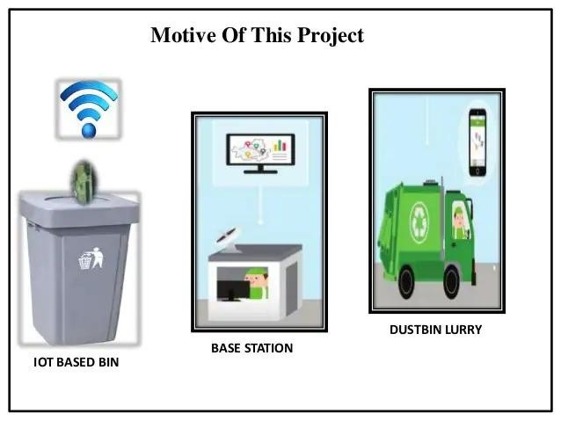
Motive of the project:

Slide 7
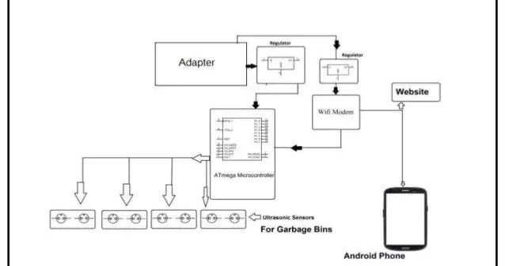
Block Diagram:

Slide 8



Hardware Components:
AVR Family Microcontroller WIFI Modem
LED
LCD display Adapter Ultrasonic Sensors Resistors Capacitors
Diodes

Slide 9


Software Components:
AVR Studio
MC Programming Language :Embedded C Arduino Software

Slide 10
Applications:
Empowered Swatch Bharat Mission. Support Digital India .
Real time based monitoring waste Collection.
It makes Our system transparent between Municipal corportion , Workers and Public.

Slide 11
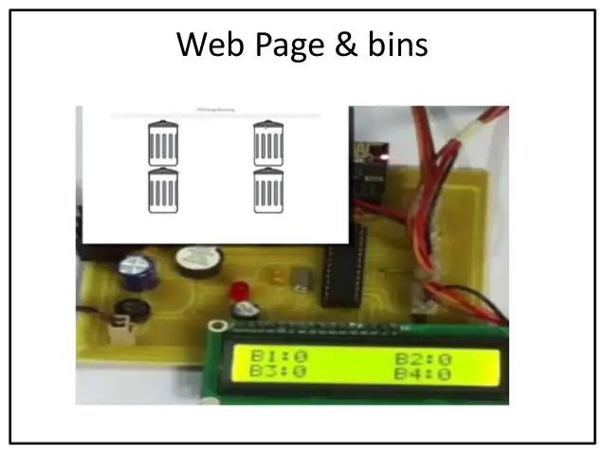
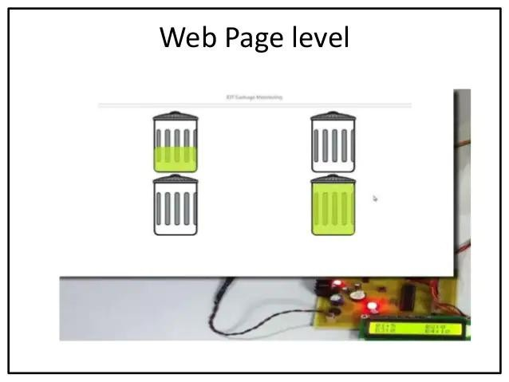
Output:

Slide 12

Conclusion:
The developed system provides a improved database for waste management collection time and quantity of garbage collection at each location .
By Implementing this project we will avoid over flowing of waste from the container in residential area which is previously either loaded manually or with the help of loaders in traditional trucks.
Development of applications for city administrations,municipal staff

Slide 13
Thank You

